Slide 1
Micro-CreditDefaulter Model
Submitted By
Sumukh Anand Sinai Kunde

Slide 2
Acknowledgment
I acknowledge Flip RoboTechnogies to provided the data with the help of these data perform the task.I referred to given data and perform the given task.With the help of data tarined pratice project I have complited these project.

Slide 3
Introduction
Business Problem Farming:
This is a Business Problem which helps Microfinance Institution and which ever company who gives the loan reduce the credit risks by granting potential Defaulter.
Conceptual Background of the Domain Problem:
Earlier advancement of Data Science ,loan giving companies used to high risk of Defaulting. Many a consumer would display inconsistent financial and repayment behavior after being approved the loan. Machine Learning may helps lender predict potential defaulters before approving their past data. The consumer income and repayment behavior can be important metrics.
Review of Literature:
A Microfinance Institution is an oragnization that offers finacial services to low income populations.MFS becomes very useful when targeting the unbanked poor families living in village area with not much source of money.The Microfinance Services provided by MFI is group loans,agriculture loans,Individual Business loans so on.

Slide 4
Many Microfiance institution ,experts and donarsare supporting the idea of using mobile financial services which they feel are more convenient and efficient and cost saving,than the traditional high touch model used since long for the purpose of delivering microfinance services.Though,the MFI industry is primarily focusing on low income families and are very useful in such areas,the implimatations MFShas been uneven with both significant challenges and successes.
Today,microfinance isn widely accepted as poverty-reduction too,representing $70 billion in oustanding loans and global outreach of 200 millions client.

Slide 5
Motivation for the Problem Undertaken
We are working with a such a client in telecom industry.They are fixed wireless telecommunication network provider.They have launched various products and developed its businessa and organization based on the project budget operator model,offering better products at lower price to all value customers through strategy of disruptive innovation that focuses on the subscriber.They understand the importance of communication and how its affects person’s life thus,focusing on the providing their services and products to low income families and poor customers that can help them in the need of hour.

Slide 6
Data Inputs- Logic- Output Relationships
I found the data was imbalanced for the target feature (87.5% for non-defaulter and 12.5% for defaulter).Also I found that the data has some unrealstic values such as 998650 days which is not possible also there were negative values.all these unrealstic values were drop which cause data loss of 8 to 9% only.

Slide 7
Data Preprocessing Done
Data Exploration and cleaning on data exploration,i found that that dataset was imbalanced for that target feature(87.5% for Non-defaulter and 12.5% for defaulters).Also I found that the data had some unrealistic values such as 998650 days which is not possible.Also there were negative values .All the unrealistic value drop which caused 8% to 9% data loss only.

Slide 8
State the set of assumptions (if any) related to the problem under consideration
Here, you can describe any presumptions taken by you.
There was outliers present in the dataset,after removing outliers the data was loosing 18% of data since the data expensive I don’t remove the outliers and removed the skewness of the data.

Slide 9
Data Sources and their formats
The Micro-CreditDefaulter was in ms excel.csv format.

Slide 10
Identification of possible problem-solving approaches (methods)
When I started the my approched for solving problem by doing summary statistic which I got the desire result.

Slide 11
Testing of Identified Approaches (Algorithms)
I performed 7 Algorithms in which 4 were model library like :
Logistic Regression
SVC
DecisionTreeClassifier
KNeighborsClassifier
Out of 7, 3 were boosting model library like
RandomForestClassifier
AdaBoostClassifier
GradientBoostingClassifier

Slide 12
Run and Evaluate selected models
Since it was supervised classifiaction problem after evaluating performance of the model I performed with GridSearchCV and after that the data was huge so that I manually performed hypertuning with RandomForestClassifier I got increased in accuaracy score and metrics.I performed with 7 algorithms which I found RandomForestClassifier highest in accuracy also curve is tending towards ideal shape.

Slide 13
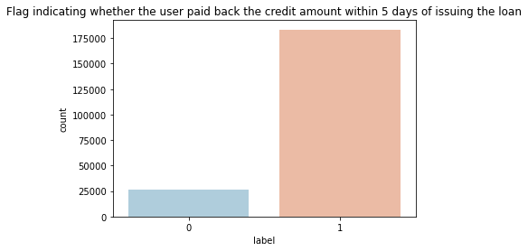
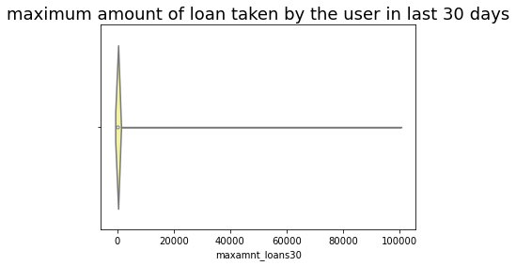
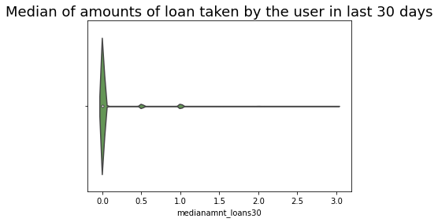
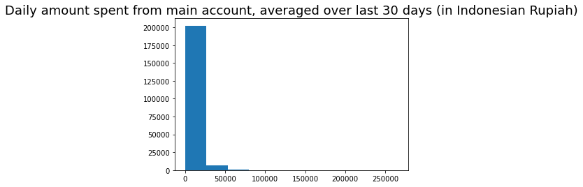
Visualizations

Slide 14
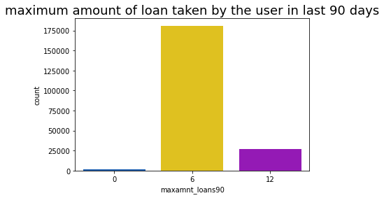
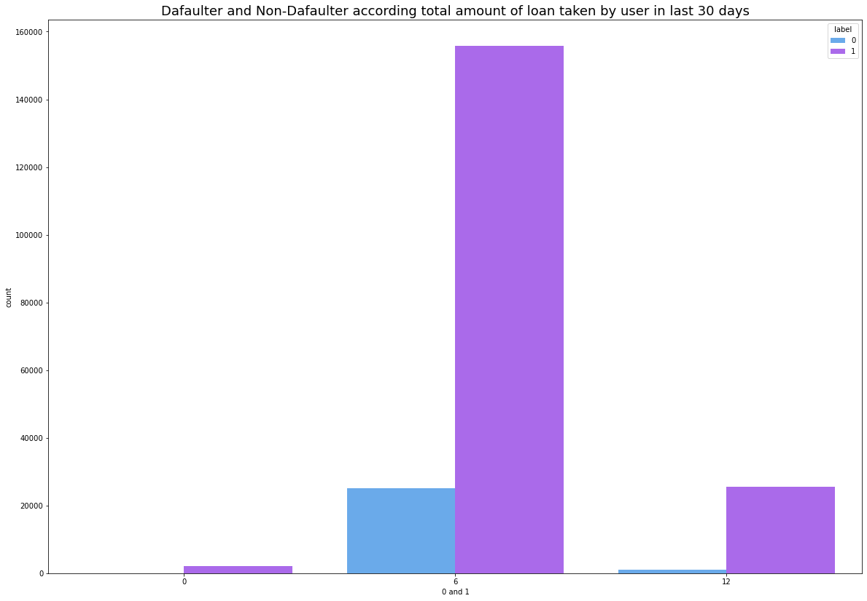
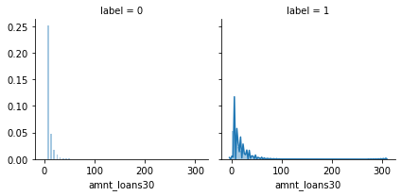

Slide 15
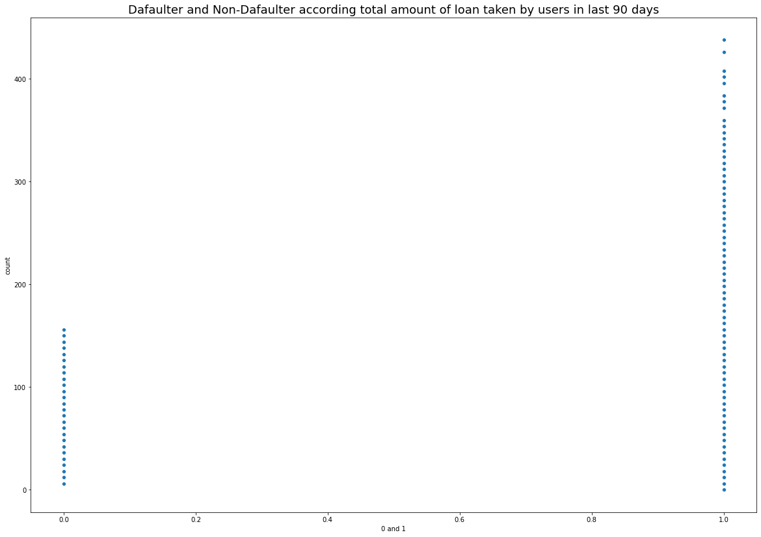

Slide 16
Interpretation of the Results
After visiulization I found that 183431 thousand consumer has paid the loan in 5 days and 26162 has failed to pay the loan in 5 days as they have not maintaine the balance in main account.after seeing plot I found that telecom industry are in good shape.

Slide 17
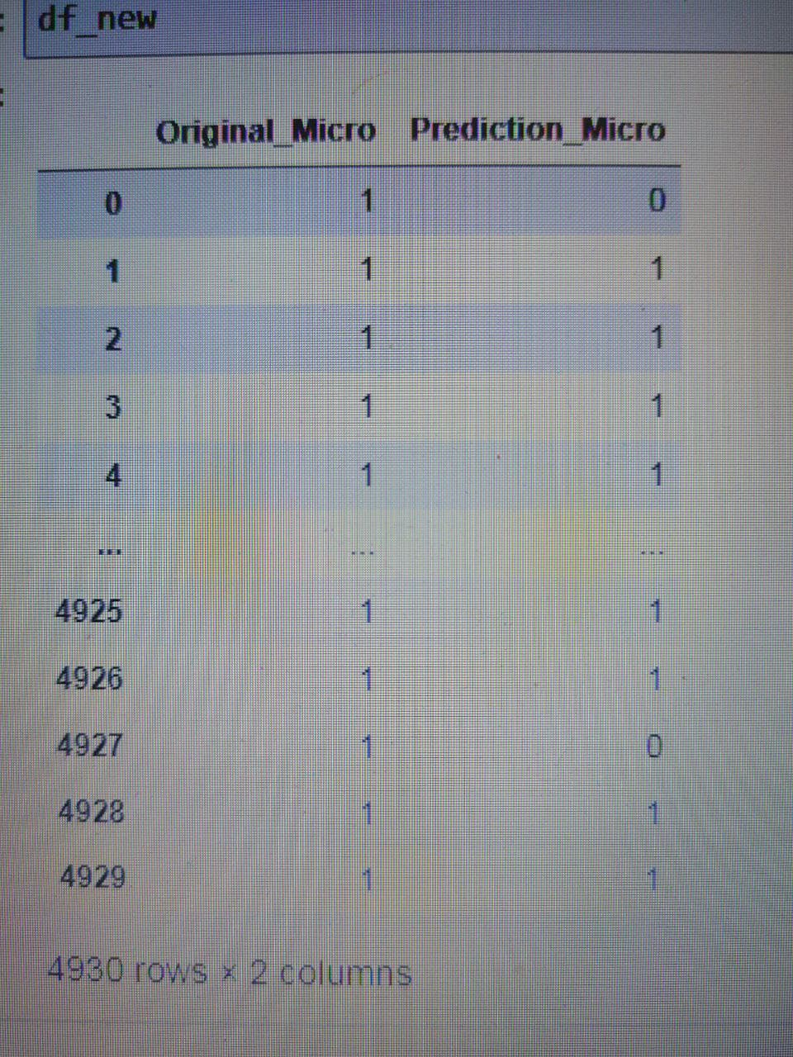
Key Findings and Conclusions of the Study

Slide 18
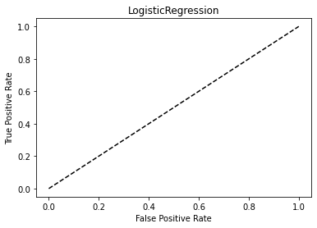
LogisticRegression

Slide 19
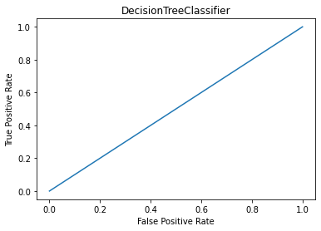
DecisionTreeClassifier

Slide 20
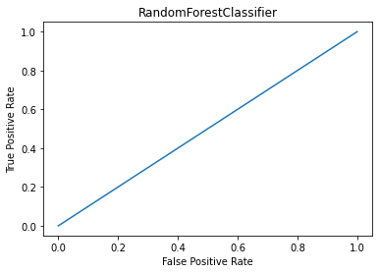
RandomForestClassifier

Slide 21
Learning Outcomes of the Study in respect of Data Science
LogisticRegression:The data was binary classification 0 and 1 ,LogisticRegression is easier to train and implement as compared to other methods.LogisticRegression works well for cases where the dataset is linearly separable.A data set is said to be linearly separable if it is possible top draw a staight line that can separate the two classes of data from each other.
While working on this project the data was inbalance,complex very difficult to understand ,after visiulization I found some idea how the data is and then I clean the data which some data was unrealistic.
In this project I found RandomForestClassifier as a best model with good accuracy.RandomForest is a supervised learning algorithms.The forest it build is an ensemble of decision tree,usually trained with the bagging method.The general idea of the bagging method is that a combination of learning models increase the overall result.

